Slide 1
PRODUCT ORIENTED ARCHITECTURE
Clever Subtitle
Rob Spectre, Director of Devangelism
@dN0t – rob@twilio.com

Slide 2
BUT FIRST...

Slide 3
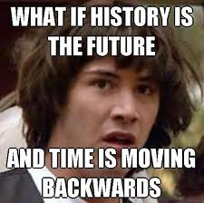
HISTORY. WHOA.

Slide 4
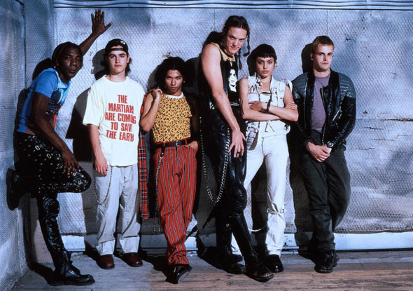
HACKING IN 1995

Slide 5
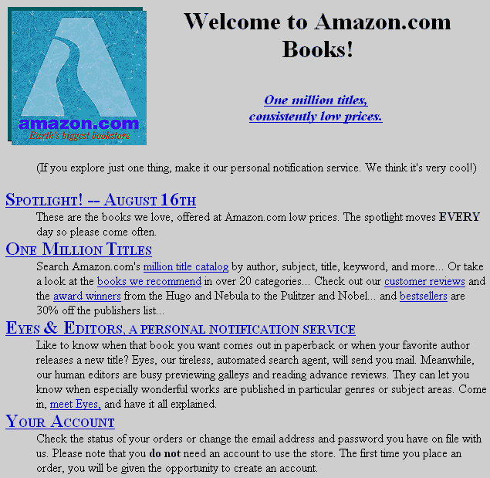
AMAZON IN 1995

Slide 6
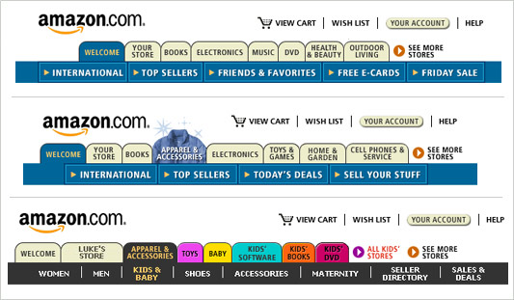
AMAZON IN 2001

Slide 7
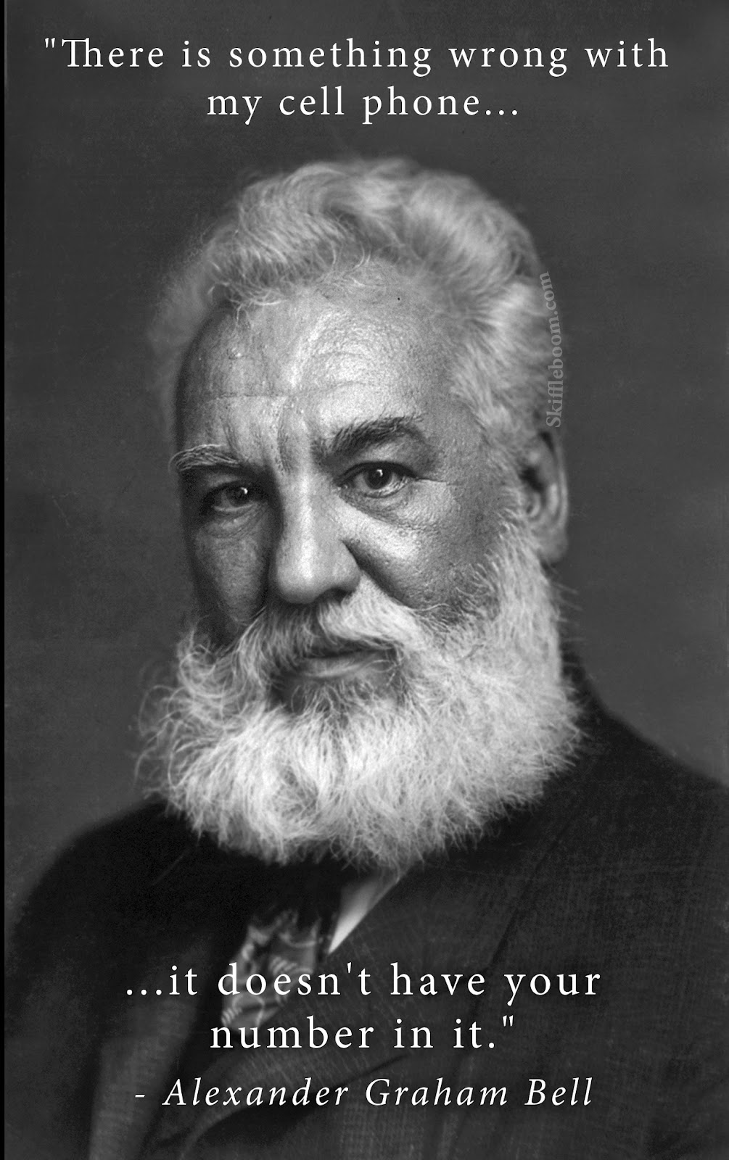
TECHNICAL ACHIEVEMENT

Slide 8
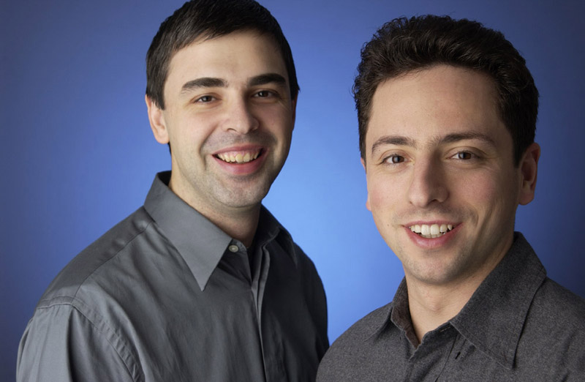
WHEN LARRY MET SERGEY

Slide 9
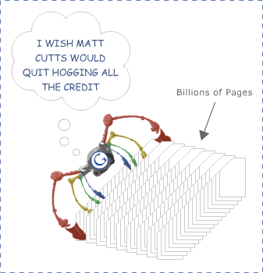
EVERYDAY I'M CRUFTLIN'

Slide 10
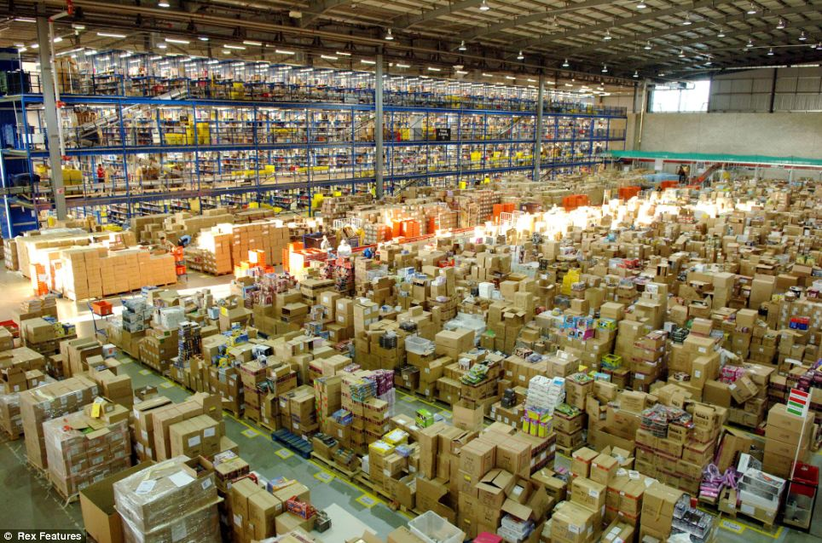
ALL THE THINGS

Slide 11

ALL THE PIPELINES

Slide 12

ALL THE WEIGHT

Slide 13
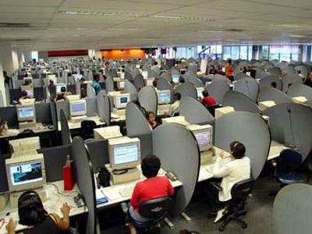
ALL THE CALLS

Slide 14

ALL THE MOOLAH

Slide 15
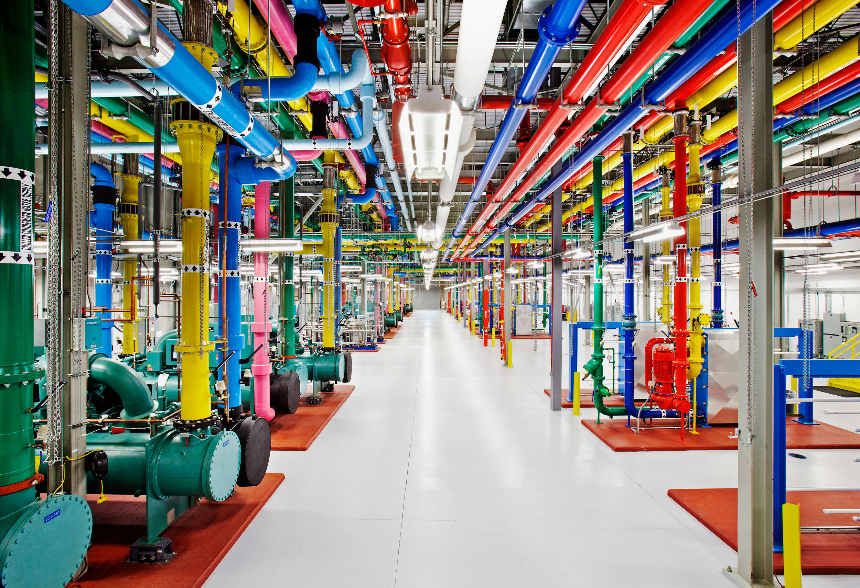
FLASHY THERMALS

Slide 16
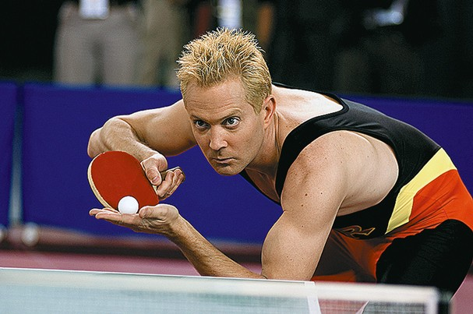
FLASHY PADDLE

Slide 17
AND THEN...

Slide 18
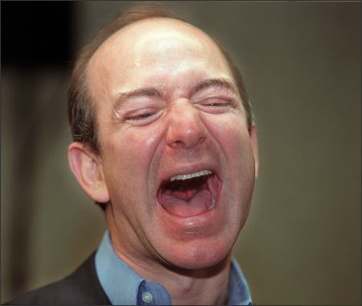
NO LAUGHING MATTER

Slide 19
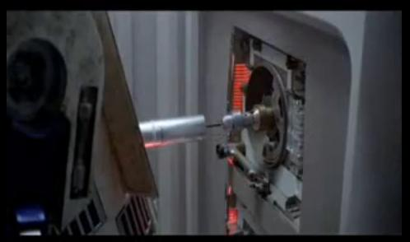
INTERFACES ONLY

Slide 20

THIS CONVERSATION SEEMS BORING

Slide 21
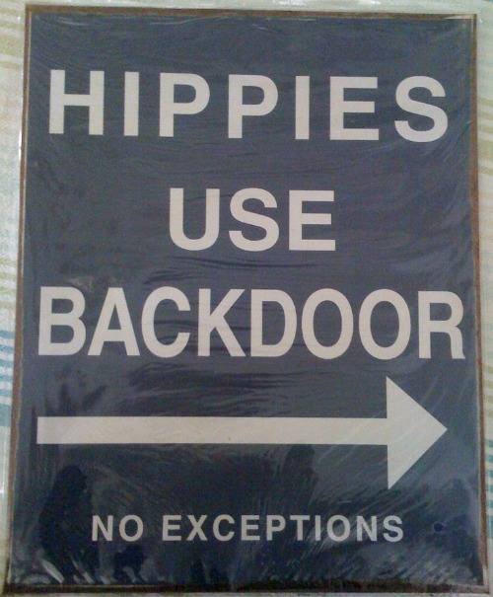
FINALLY.

Slide 22

IMPLEMENTATION DETAILS?

Slide 23

PLUG IT RIGHT IN

Slide 24

YOU'RE FIRED

Slide 25
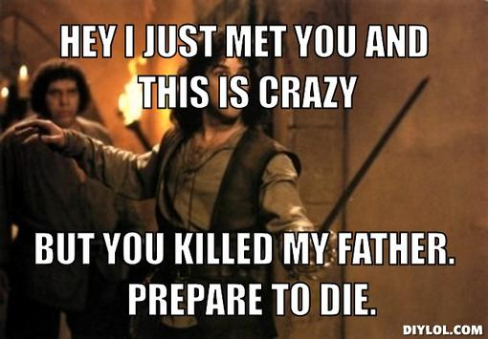
SIX FINGERED CRAZY

Slide 26
AND NOW...

Slide 27
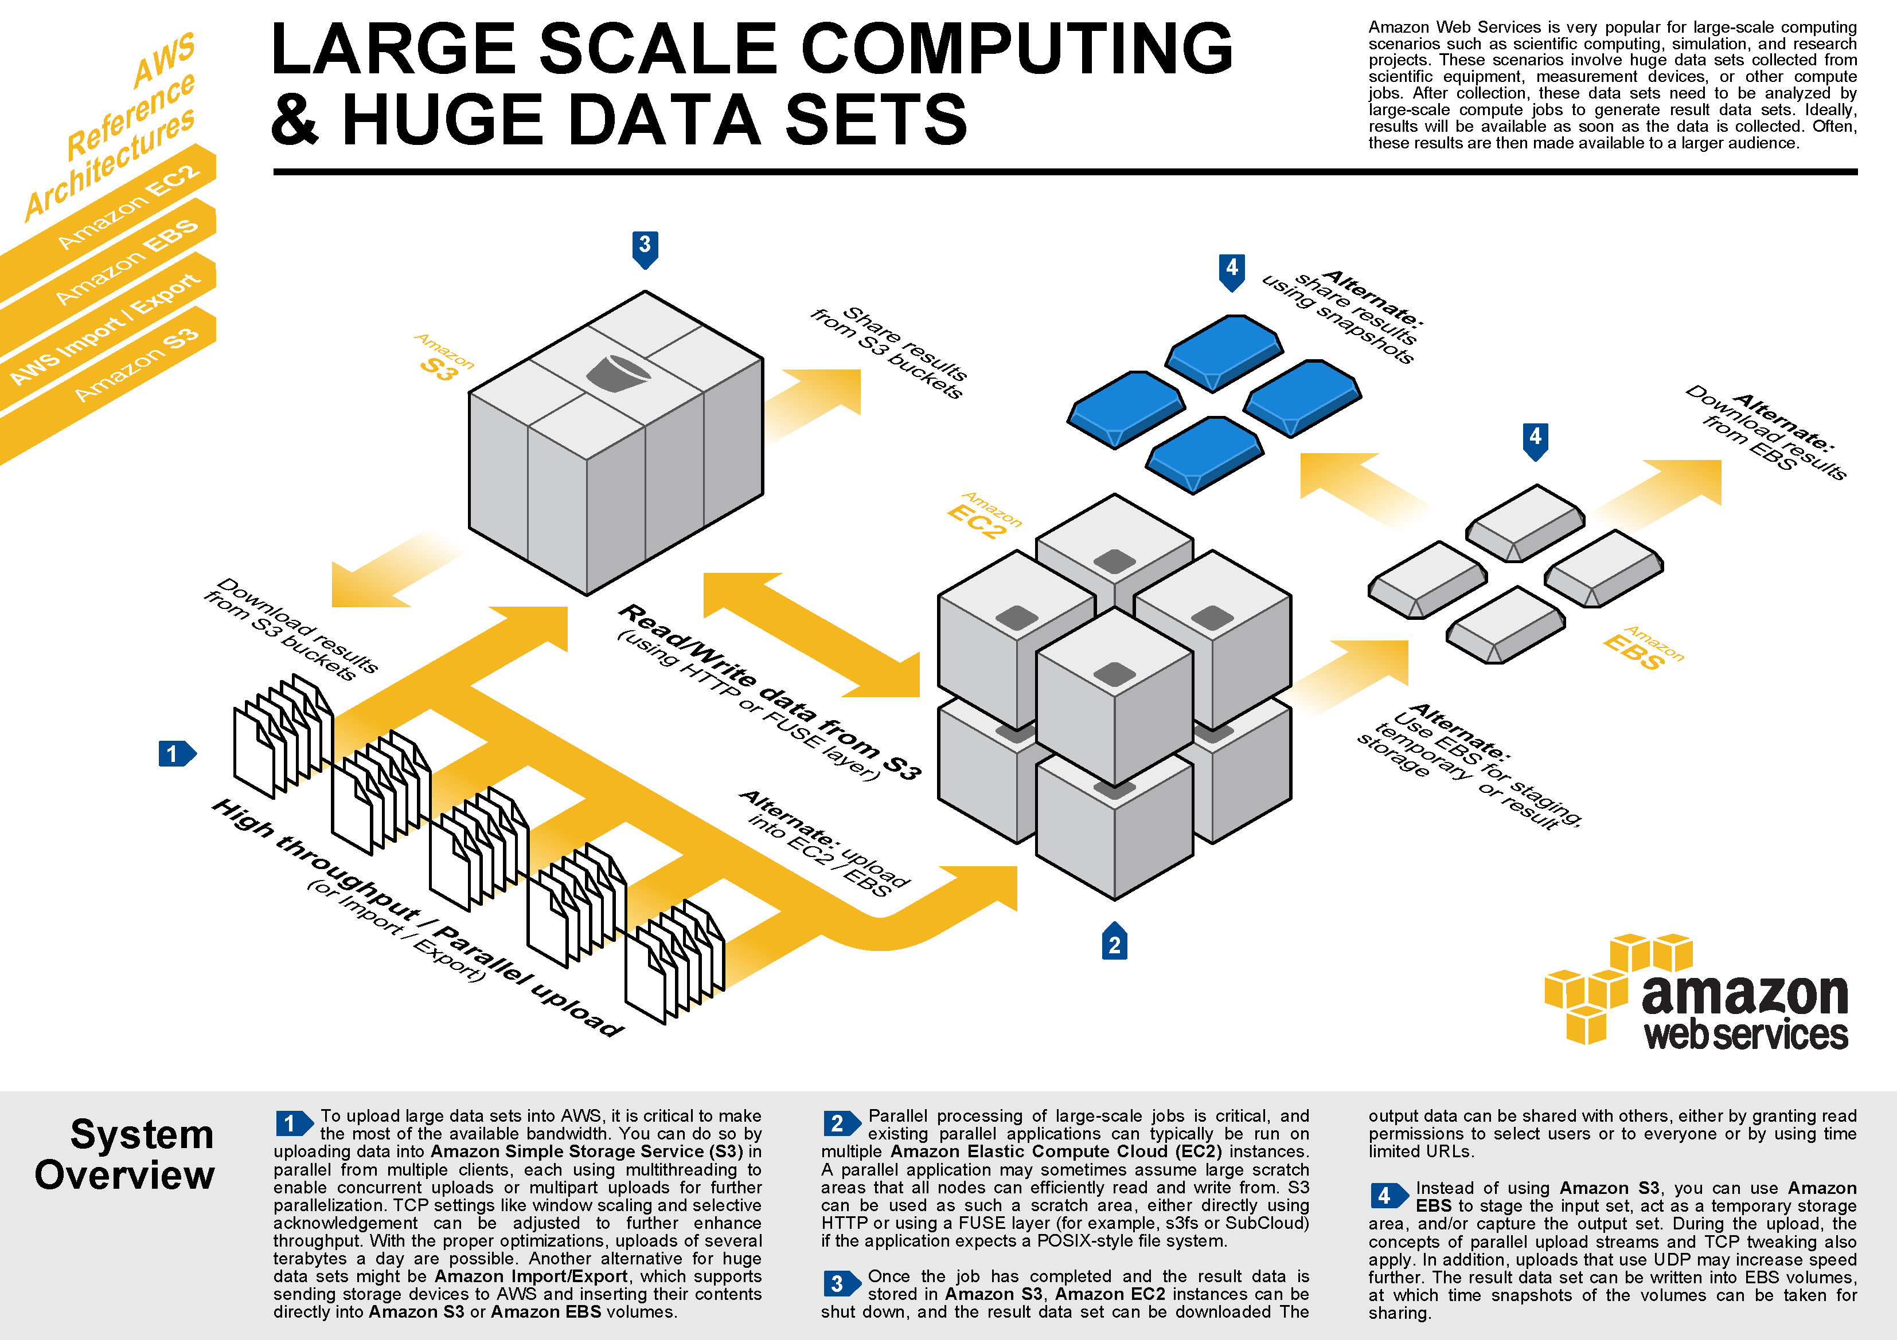
DIAGRAMS ARE INTENSE

Slide 28

RAPID EXPANSION

Slide 29
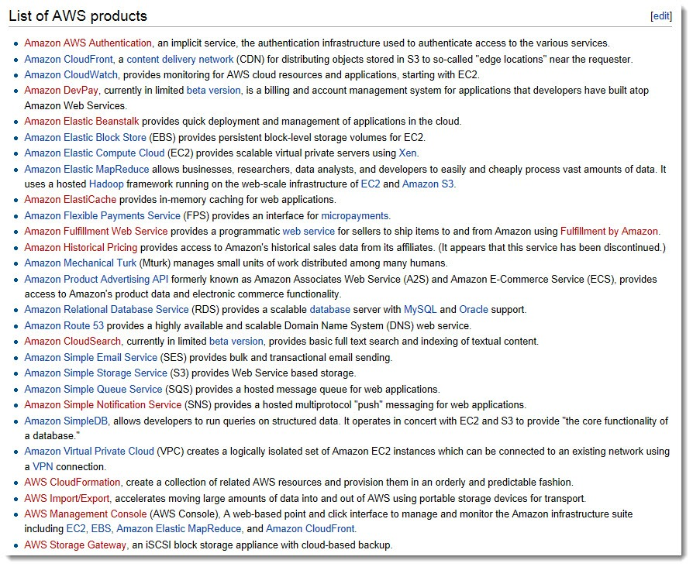
HOLY BISCUITS

Slide 30

TRAVEL LIKE A HUMAN

Slide 31

WHAT DOES IT MEAN?

Slide 32

BILLION. SRSLY.

Slide 33

COPY / PASTE

Slide 34

SHAMELESS PLUG

Slide 35
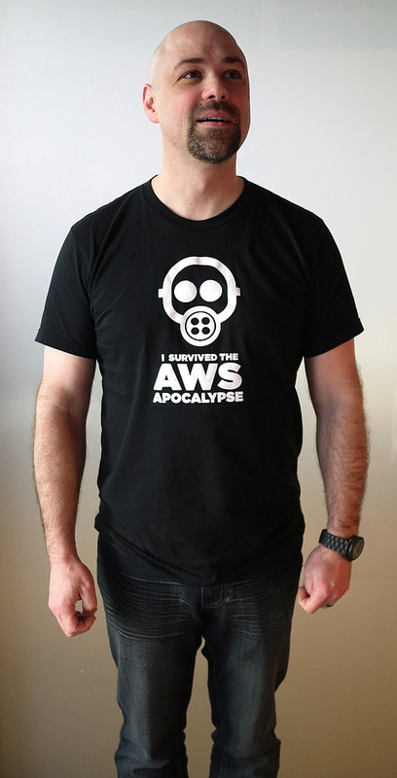
PORKCHOP SANDWICHES

Slide 36
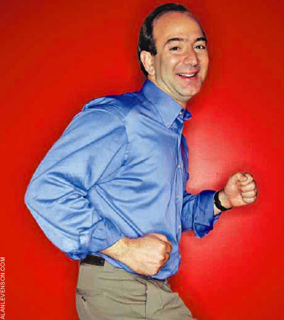
EVERYDAY I'M SHUFFLIN'

Slide 37
O HAI.

Slide 38

SOA

Slide 39
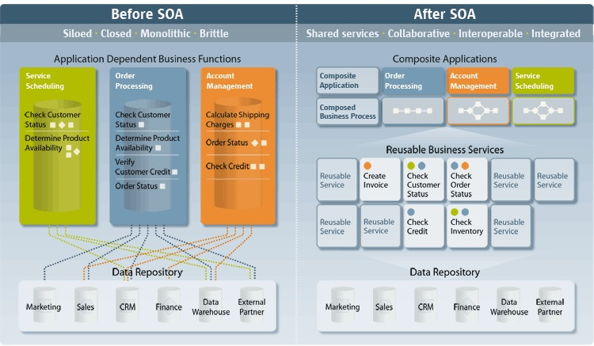
FLOWCHARTS. YEAH BUDDY.

Slide 40

ONE TRICK PONY

Slide 41
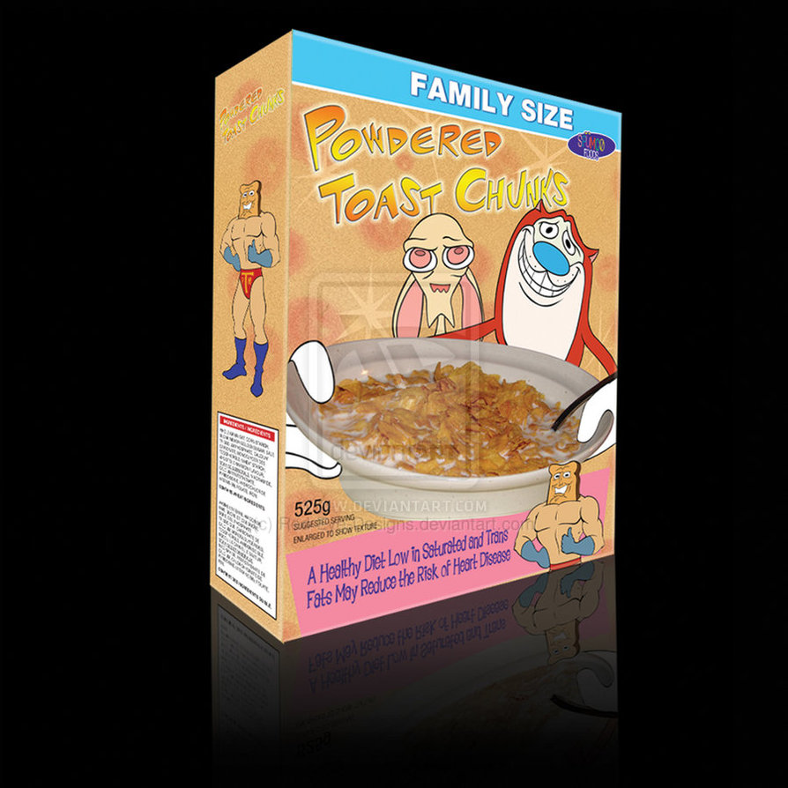
PRODUCTS HAVE BOXES

Slide 42
API != PRODUCT

Slide 43

EXPOSURE

Slide 44
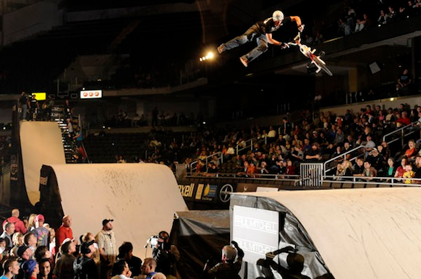
RAD BRO

Slide 45

RESPECT MY AUTHORITY

Slide 46

SSL AIN'T ENOUGH

Slide 47
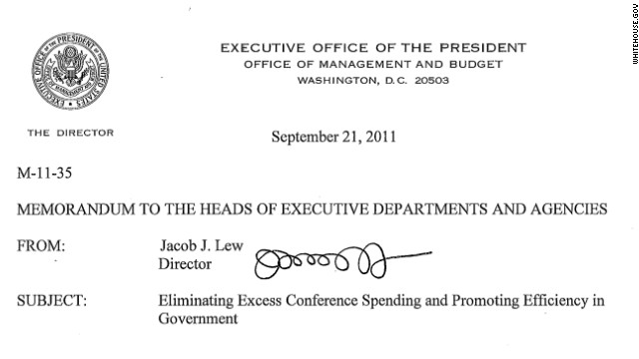
THIS DUDE PRINTS OUR MONEY

Slide 48

AVOID THIS COMMON MISTAKE

Slide 49

TOLERANCE

Slide 50
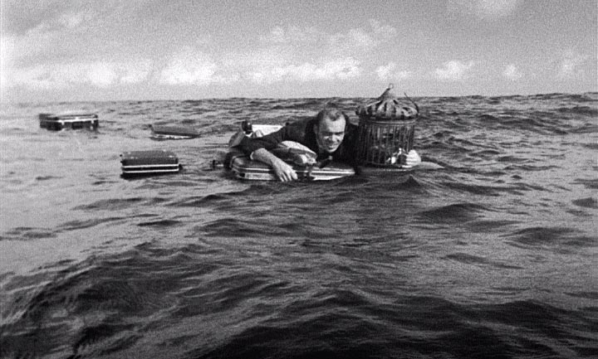
INTERNET FLOTSAM

Slide 51
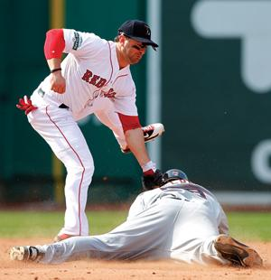
YANKEES SUCK

Slide 52
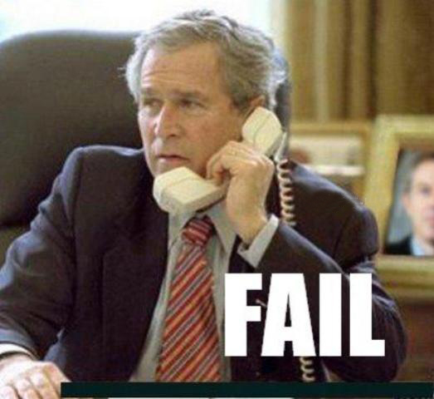
COMMUNICATION FAIL

Slide 53
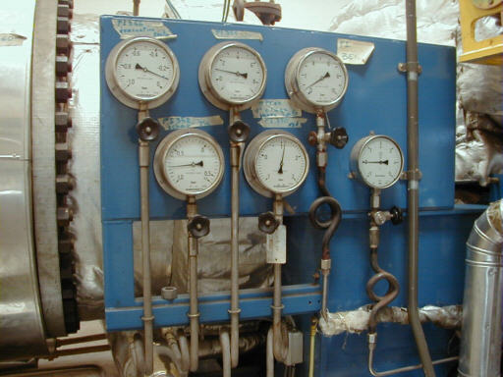
GAUGES RULE

Slide 54
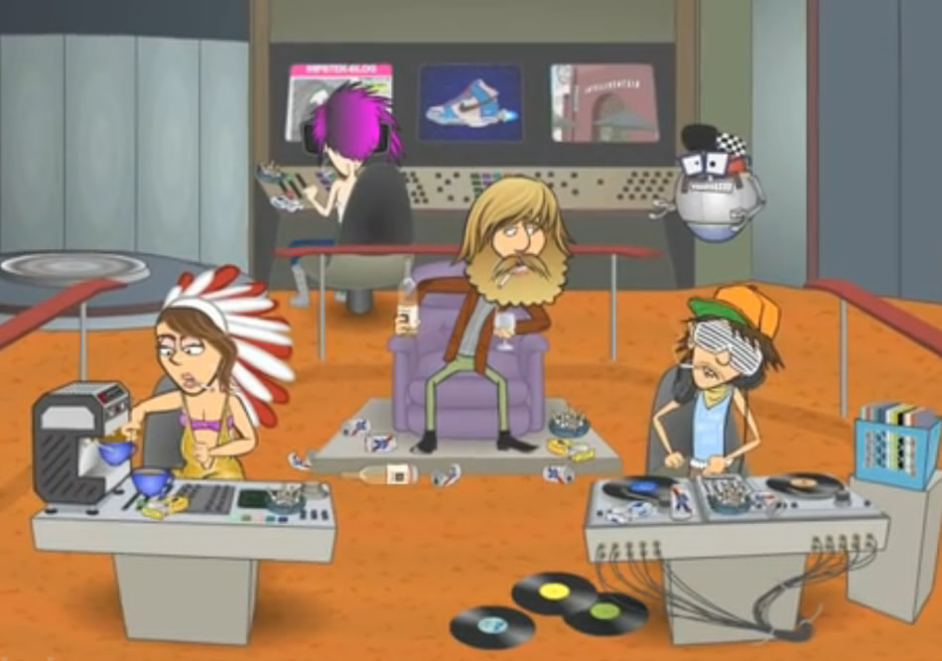
HIPSTERS IN SPACE

Slide 55

COOK WITH CARE

Slide 56

BE GREAT. ITERATE.

Slide 57
THIS SHIT IS HARD

Slide 58

SO SO HARD

Slide 59

WHY LIVE THE PAIN

Slide 60
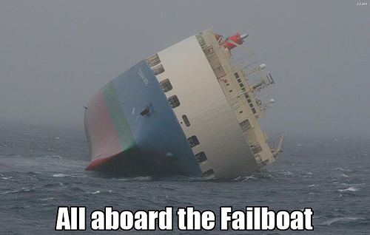
SHARED STATE IS SHARED FAIL

Slide 61
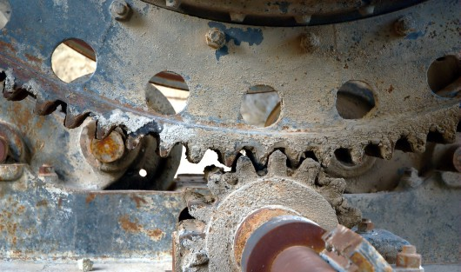
CRUFT KILLS ENGINES

Slide 62

WELL USED

Slide 63

I HEART CLOUDS

Slide 64

NOBODY EXPECTS US

Slide 65
CONCLUSIONS

Slide 66
THANK YOU
Github.com/RobSpectre/Talks
www.brooklynhacker.com
@dN0t – rob@twilio.com

